Slide 1
Time Series To infinity and beyond…. by Ralf Martin (r.martin@imperial.ac.uk)

Slide 2
Objectives of this lecture
Time Series data: Different data points represent different points in time
This introduces some additional challenges
We will discuss how to deal with those

Slide 3
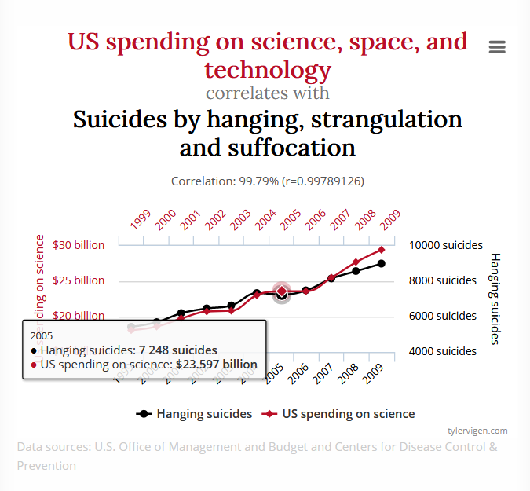
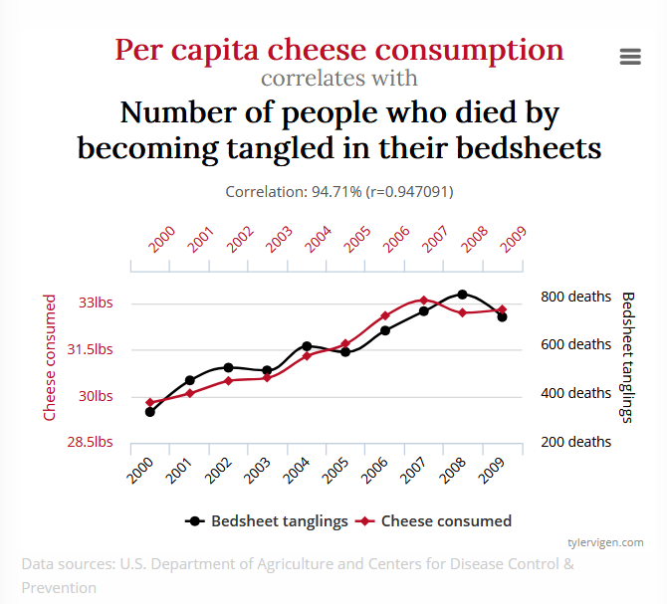
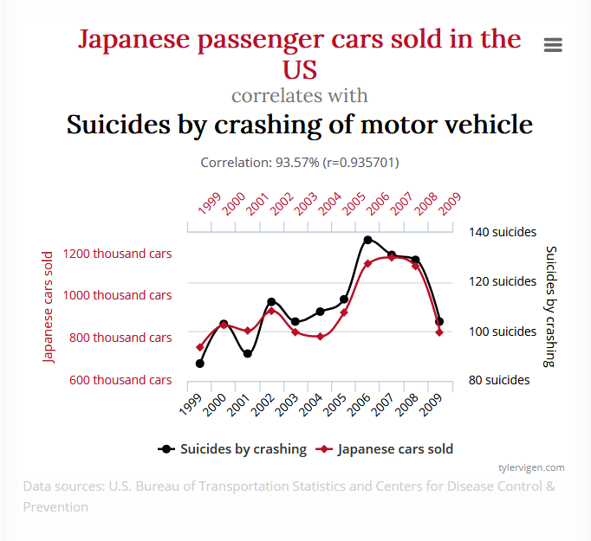
What’s the challenge of time series data?
Can you spot the problem?
Time becomes a confounding variable
Non-stationary: characteristics of data vary with time

Slide 4

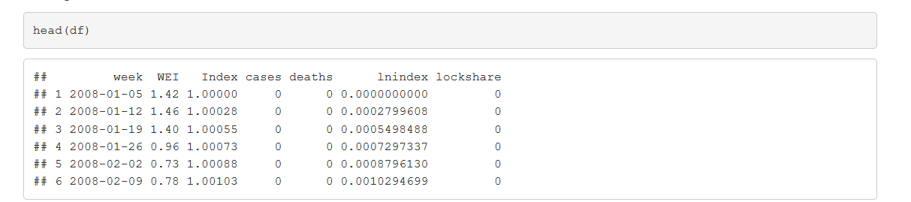
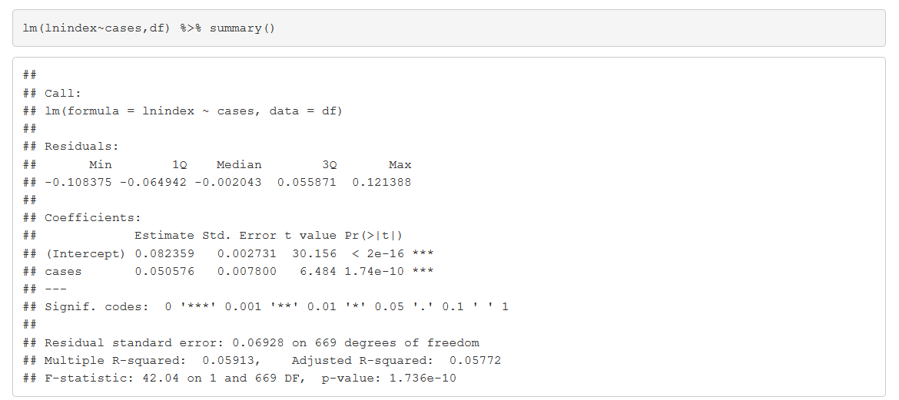
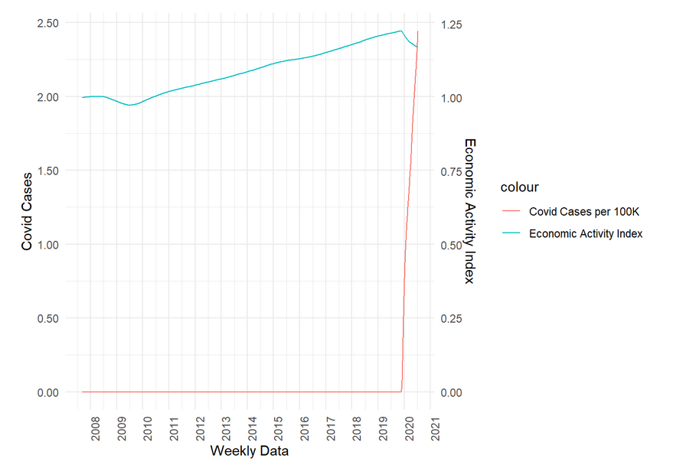
COVID vs GDP
What you think is going to happen?
More COVID = more GDP?
100K more = 5% more GDP?
In 100K of cases

Slide 5
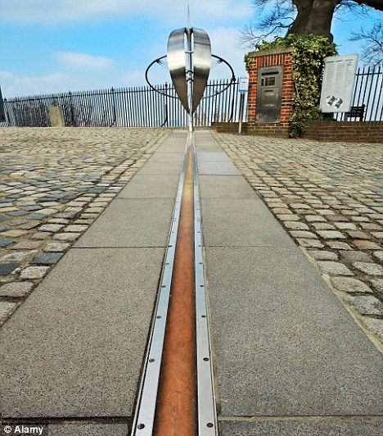
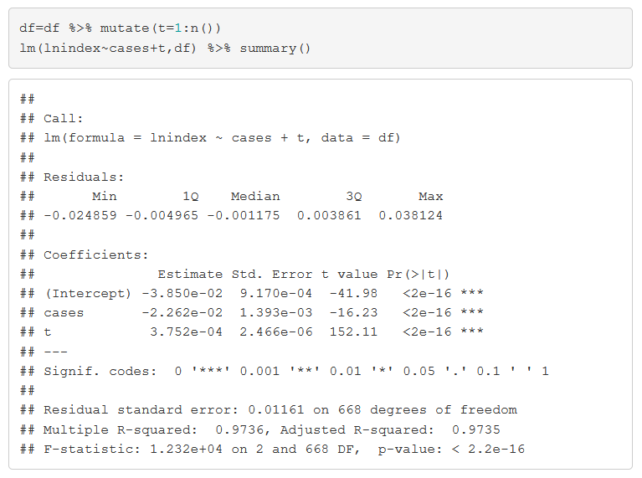
Taking control of time….with a timeline
100k more cases = 2.2% lower GDP

Slide 6
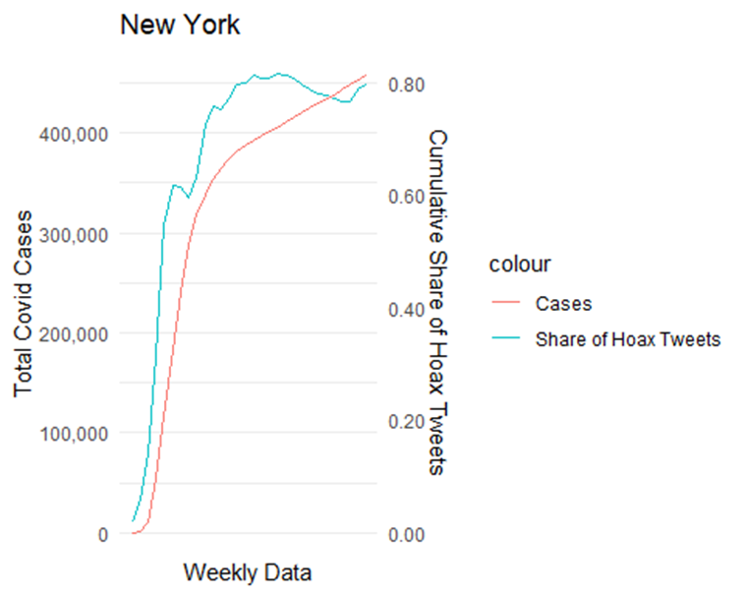
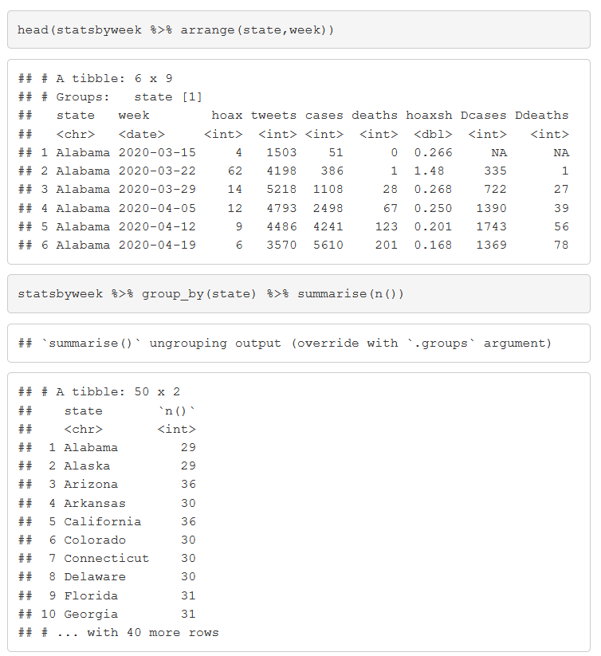
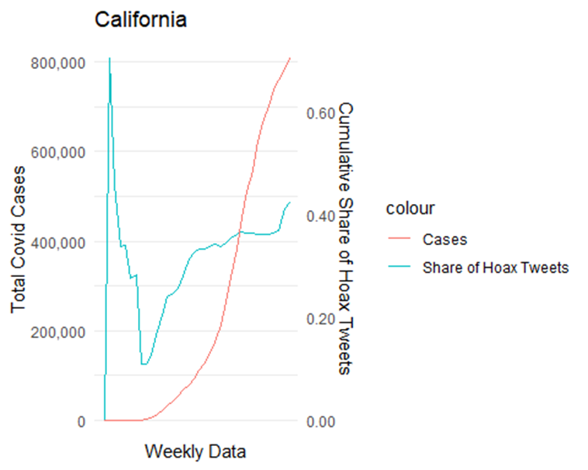
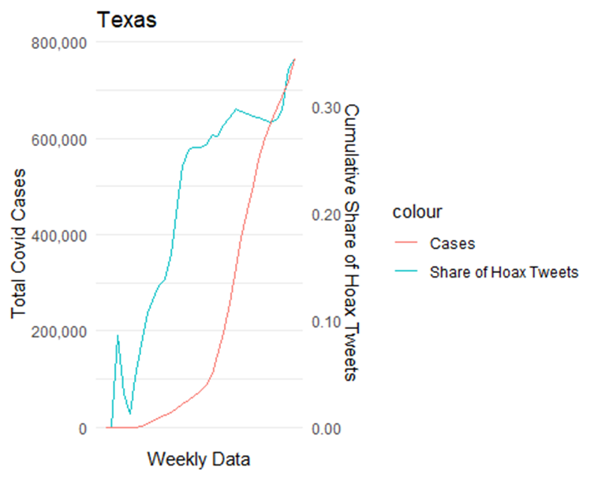
What if time is not linear?
Seasonal effects
Recessions
Natural disasters
Political turmoil
War
Pandemic
Panel data to the rescue
Multiple periods for the same cross section unit

Slide 7
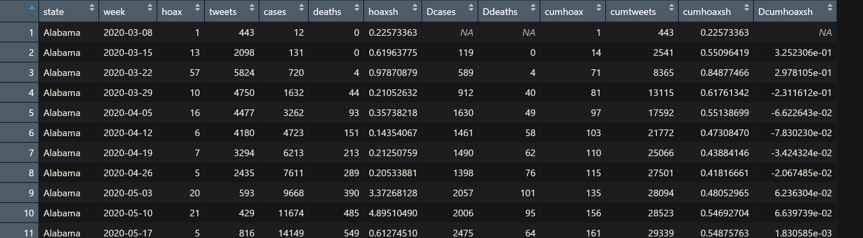
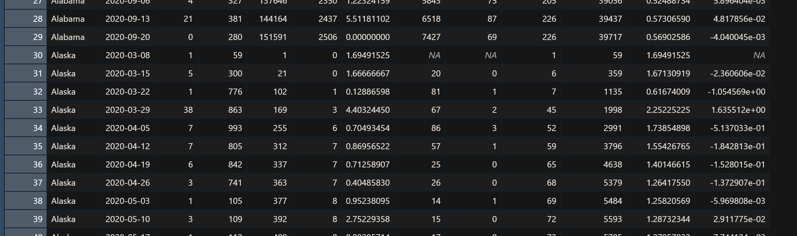
Panel data

Slide 8
Panel data example
lm(cases~cumhoaxsh+factor(state)+factor(week),statsbyweek) %>% summary()
## ## Call: ## lm(formula = cases ~ cumhoaxsh + factor(state) + factor(week), ## data = statsbyweek) ## ## Residuals: ## Min 1Q Median 3Q Max ## -244737 -21562 1446 21041 463246 ## ## Coefficients: ## Estimate Std. Error t value Pr(>|t|) ## (Intercept) -109303 41227 -2.651 0.008107 ** ## cumhoaxsh 61619 19128 3.221 0.001304 ** ## factor(state)Alaska -96560 22677 -4.258 2.20e-05 *** ## factor(state)Arizona 34689 16951 2.046 0.040899 * ## factor(state)Arkansas -9094 18337 -0.496 0.620015 ## factor(state)California 224047 17120 13.087 < 2e-16 *** ## factor(state)Colorado -8425 17692 -0.476 0.634008 ## factor(state)Connecticut 4626 18572 0.249 0.803343 ## factor(state)Delaware -31191 17875 -1.745 0.081207 . ## factor(state)Florida 206617 17752 11.639 < 2e-16 ***
Hoax share up by 1 percentage point means 121120 more cases
Also controlling for state
Smaller effect when controlling for time (week) effects
e.g.: more rural and less densely populated states have also less people engaged in hoax conspiracies
Example issue: suppose in some weeks there are school holidays (and hence a lower number of covid cases). Also suppose that hoax tweeters are more active over the holidays

Slide 9
Time and cross sectional unit as co-founder
COVID Cases
Hoax Share
Events in a particular week
COVID Cases
Hoax Share
Characteristics of particular state

Slide 10
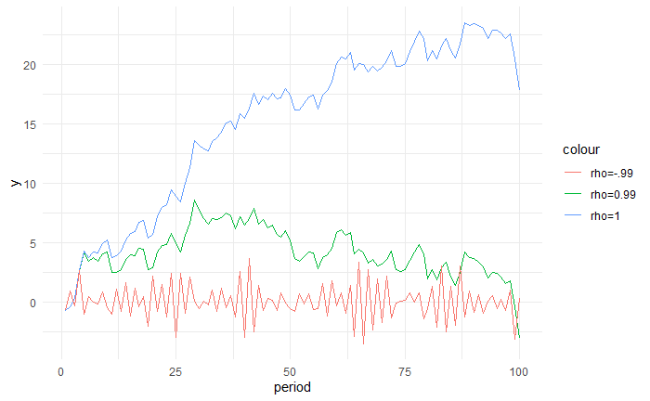

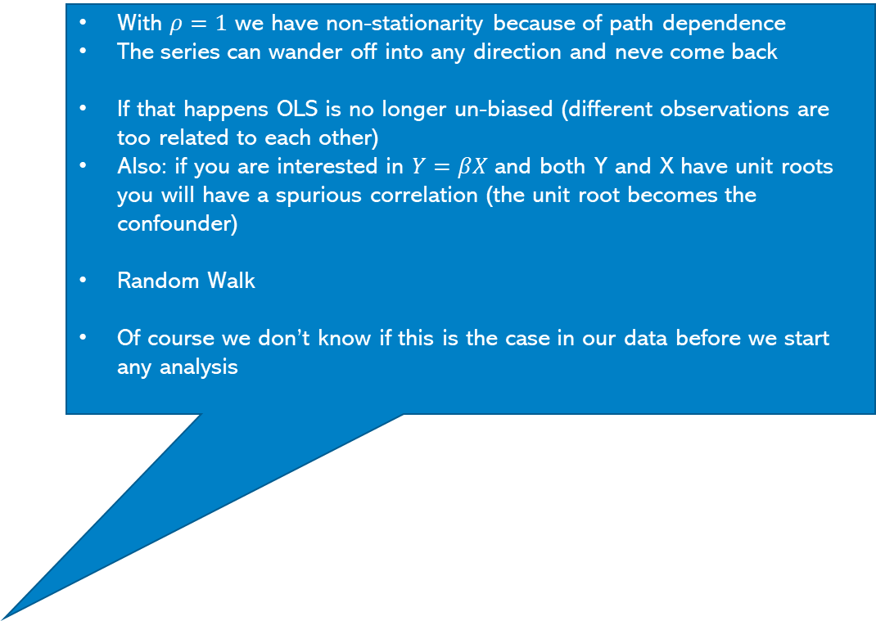
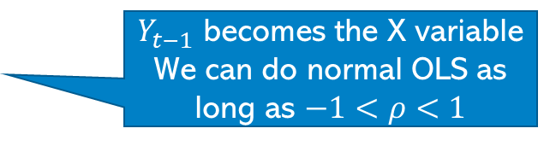
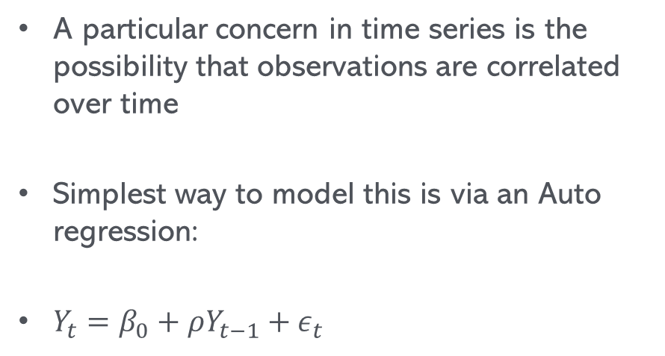
Autoregression
With $ρ=1$ we have non-stationarity because of path dependence
The series can wander off into any direction and neve come back
If that happens OLS is no longer un-biased (different observations are too related to each other)
Also: if you are interested in $Y=βX$ and both Y and X have unit roots you will have a spurious correlation (the unit root becomes the confounder)
Random Walk
Of course we don’t know if this is the case in our data before we start any analysis
A particular concern in time series is the possibility that observations are correlated over time
Simplest way to model this is via an Auto regression:
$Y_{t}=β_{0}+ρY_{t−1}+ε_{t}$
$Y_{t−1}$ becomes the X variable
We can do normal OLS as long as $−1<ρ<1$

Slide 11
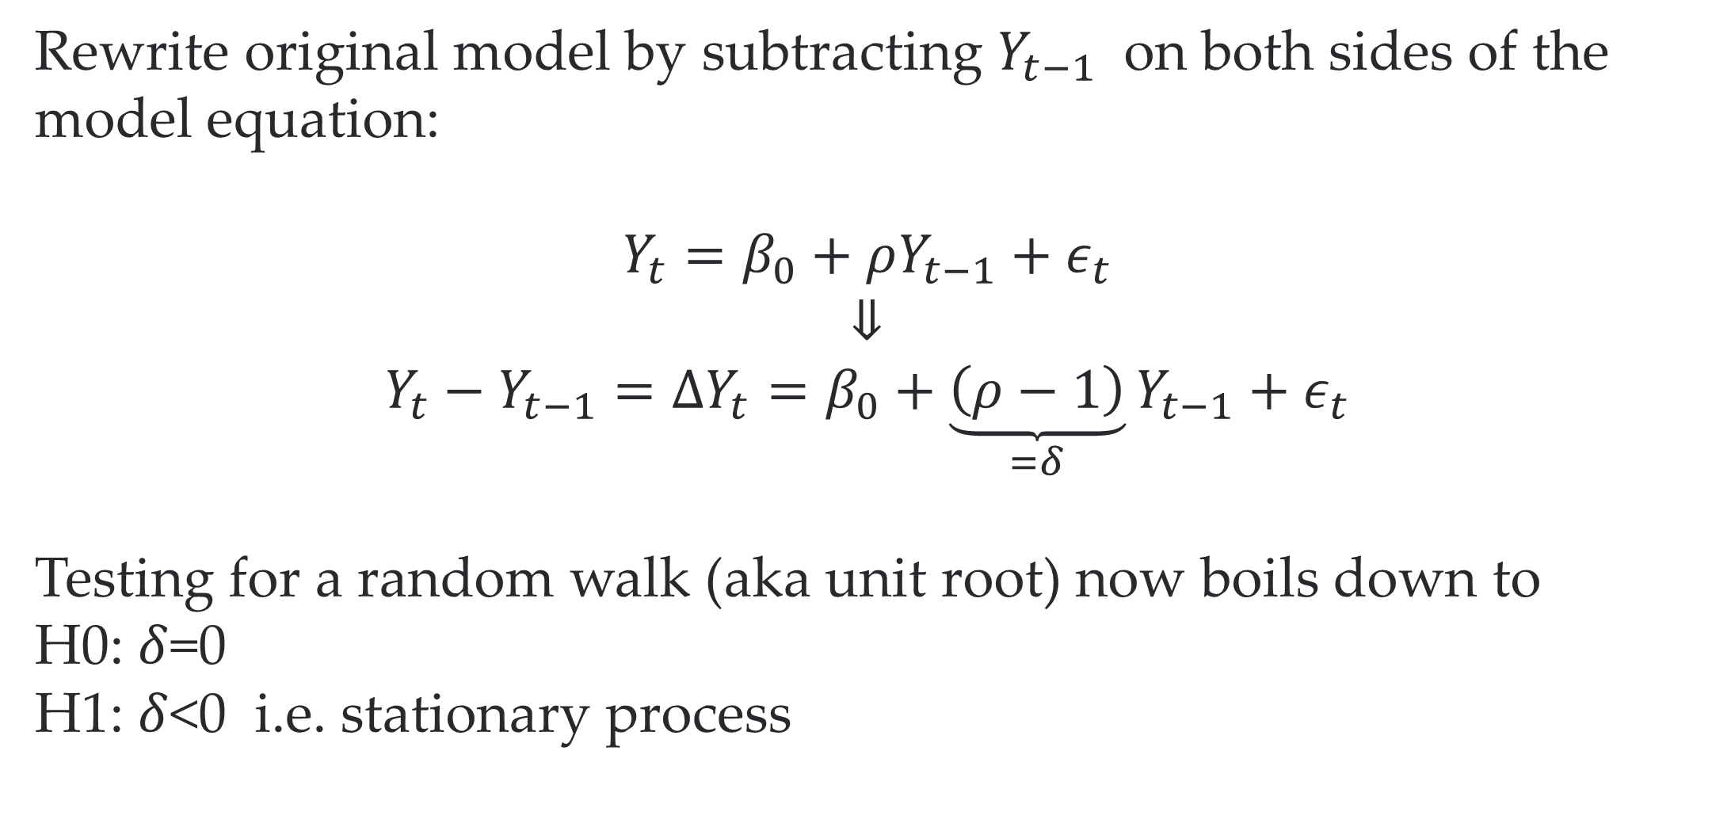
Dickey-Fuller test to the rescue
Rewrite original model by subtracting $Y_{t−1}$ on both sides of the model equation:
$$Y_{t}=β_{0}+ρY_{t−1}+ε_{t}$$
⇓
$$Y_{t}−Y_{t−1}=ΔY_{t}=β_{0}+\underset{=δ}{\underbrace{\left(ρ−1\right)}}Y_{t−1}+ε_{t}$$
Testing for a random walk (aka unit root) now boils down to
H0: $δ$=0
H1: $δ$<0 i.e. stationary process
We cannot just compare the implied test statistic to a normal t-table
Luckily R will help us

Slide 12
R to the rrrrrescue
library(urca) ur.df(df$lnindex) %>% summary()
## ## ############################################### ## # Augmented Dickey-Fuller Test Unit Root Test # ## ############################################### ## ## Test regression none ## ## ## Call: ## lm(formula = z.diff ~ z.lag.1 - 1 + z.diff.lag) ## ## Residuals: ## Min 1Q Median 3Q Max ## -8.343e-04 -2.643e-05 4.240e-06 4.131e-05 1.922e-04 ## ## Coefficients: ## Estimate Std. Error t value Pr(>|t|) ## z.lag.1 -2.155e-05 2.703e-05 -0.797 0.426 ## z.diff.lag 9.924e-01 5.596e-03 177.334 <2e-16 *** ## --- ## Signif. codes: 0 '***' 0.001 '**' 0.01 '*' 0.05 '.' 0.1 ' ' 1 ## ## Residual standard error: 7.414e-05 on 667 degrees of freedom ## Multiple R-squared: 0.9812, Adjusted R-squared: 0.9811 ## F-statistic: 1.739e+04 on 2 and 667 DF, p-value: < 2.2e-16 ## ## ## Value of test-statistic is: -0.7971 ## ## Critical values for test statistics: ## 1pct 5pct 10pct ## tau1 -2.58 -1.95 -1.62
We cannot reject unit root because -0.7971>-1.95

Slide 13
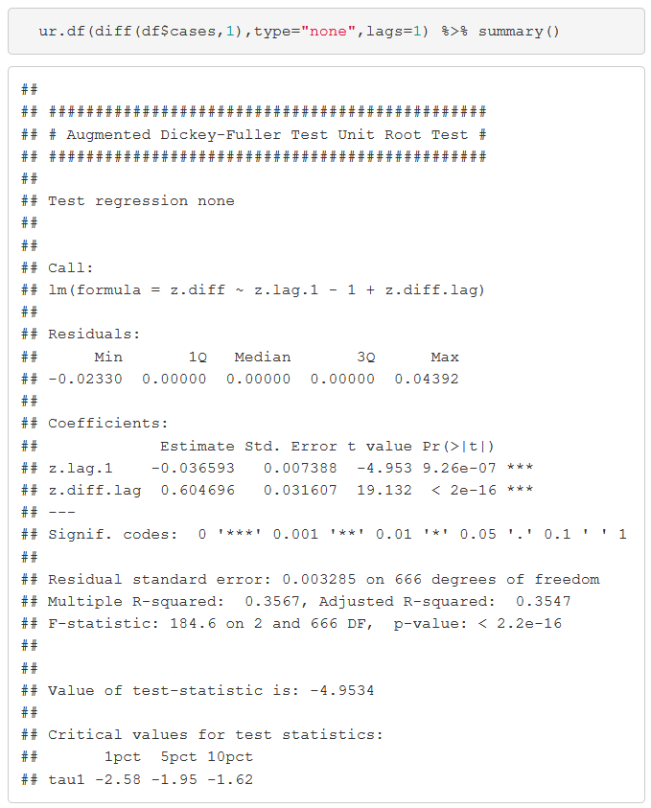
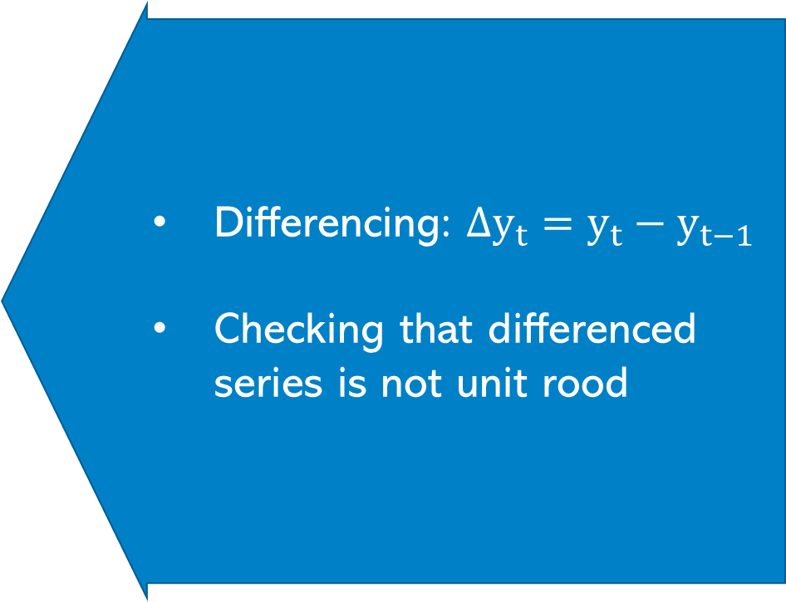
Getting rid of unit roots
Differencing: $Δy_{t}=y_{t}−y_{t−1}$
Checking that differenced series is not unit rood
We can reject unit root because -4.9534<-1.95

Slide 14
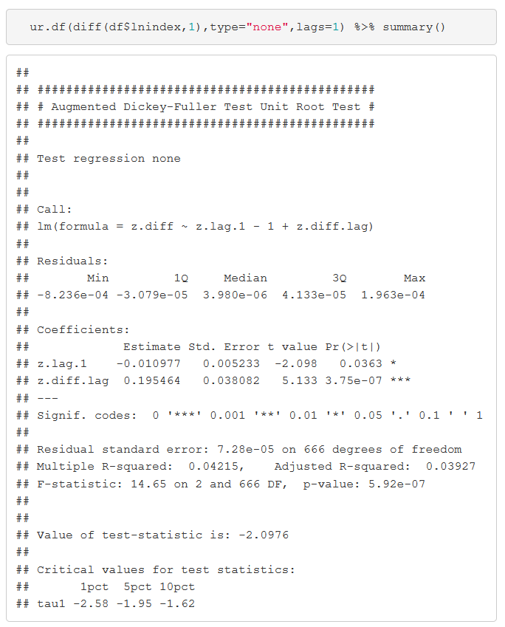
Getting rid of unit roots – Economic Activity index
We can reject unit root (at least at 5%)

Slide 15
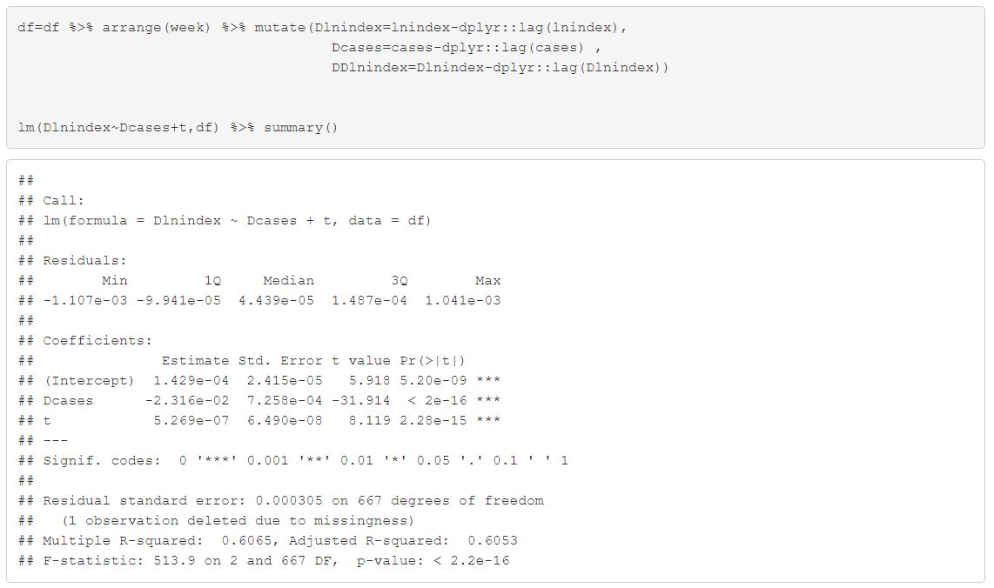
Revisiting COVID vs GDP
100k more cases = 2.3% lower GDP…similar to what we had before….but of course we didn’t know that would happen

Slide 16
Summary
Time series can be easy
But you need to worry about how stationary your series is
If the series clearly grows or shrinks continuously definitely include a time trend
However, even if it doesn’t grow (or shrink) the series might contain a unit root
If that’s the case a time trend is not enough
Use the Dickey Fuller Test to make sure you are dealing with a stationary series
If not take first difference and check Dickey Fuller again

Slide 17

Extra Slides

Slide 18
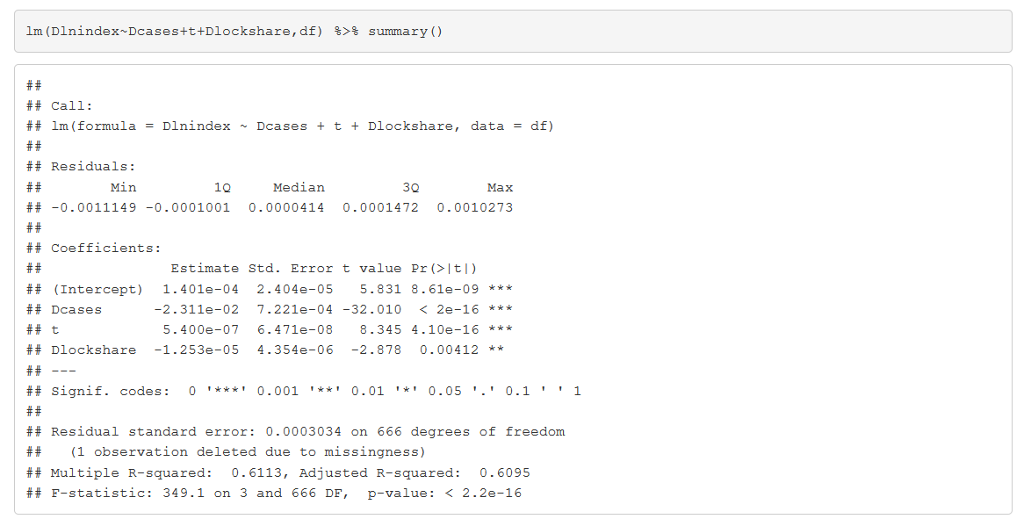
Other considerations
If 100% of US population go into lockdown GDP goes down by -0.138% (seems low..more research needed)

Slide 19

More lags AR(2)?
$$Y_{t}−Y_{t−1}=β_{0}+\left(β_{1}+β_{2}−1\right)Y_{t−1}−β_{2}\left(Y_{t−1}−Y_{t−2}\right)+ε_{t}$$
We can test this again using the coefficient on $Y_{t−1}$
More lags and trend?
$$Y_{t}−Y_{t−1}=β_{0}+\left(β_{1}+β_{2}−1\right)Y_{t−1}−β_{2}\left(Y_{t−1}−Y_{t−2}\right)+ρt+ε_{t}$$

Slide 20
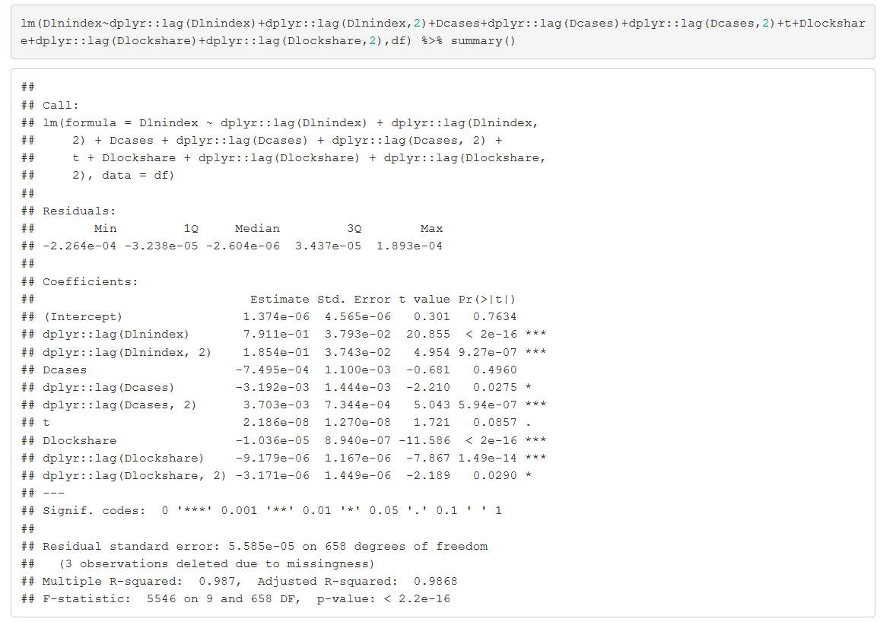
More lags

Slide 21


Further reading
On time fixed effects: Hanck et al Chapter 10.4
Unit roots: Hanck et al Chapter 14.7

